Slide 1
Peer Review for Assignments of Group 1
Group 8, Weizhao Li & Peiyao Teng

Slide 2
Checklists
We had reviewed:
Use Case Diagram
Use Case Specification
Sequence Diagram
Class Diagram

Slide 3
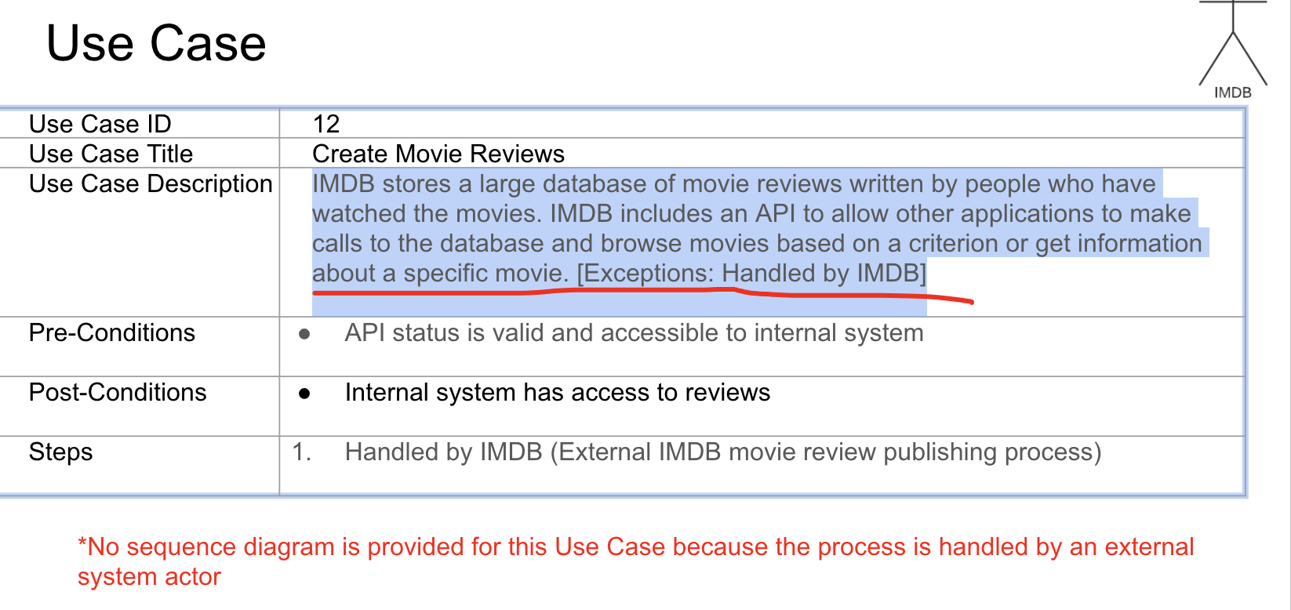
Use Case Diagram Reviews
Issue 1: Use case 3, approve / deny should be a verb + noun phrase.
Issue 2:
Since use case diagram includes use case descriptions. As for use case 12, Create Movie Reviews, when we read the description, we thought it is not clear. Can the user create the reviews? Can the moderator create the reviews? Or only people who watched the movies outside of this group can create the reviews? The use case name sometimes will confuse us, it sounds like people in this group can create movie reviews. (The class diagram looks like that moderator can trigger to create movie reviews, too). Thus, it will be better to define it much clear.

Slide 4
Use Case Diagram Reviews
Issue 3:
Use case 8:
The description is not clear, it didn’t match too much to the use case’s name. Does that mean search the specific information of a movie in the list (I guess), or just search whatever movie from the whole database?
-> use such a name like “search movie info” would be easier for people to understand
Issue 4:
Use case 7 should be a verb + noun phrase. Eg. unsubscribe group
Issue 5:
Use case 11 should be a verb + noun phrase. Eg. Vote movies

Slide 5
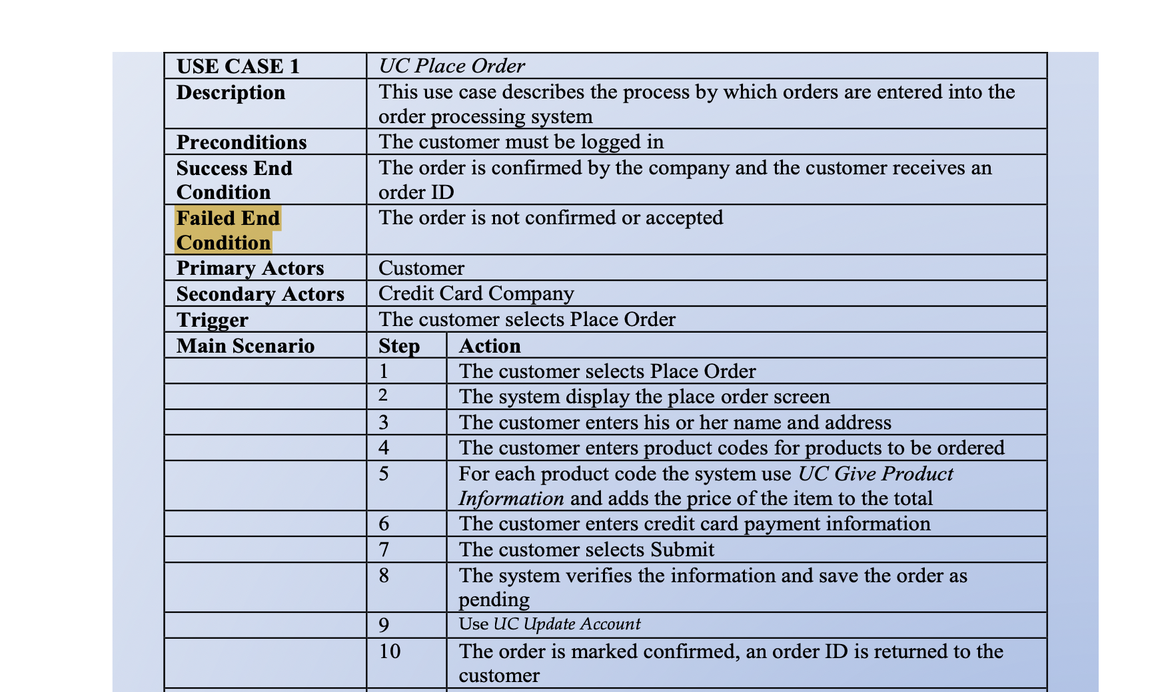
Use Case Specification Reviews
Issues 1 to 12: Same issue repeats 12 times of each use case specification.
As for Post-condition of all use cases, your team kind of misunderstanding the post-condition. In this section, you need to write two conditions that will trigger the end of this use case. One is for success, one is for failure. (Eg. what is the condition that will trigger to the success of watching the trailer and what is the condition that will trigger to failure of watching the trailer? )
Example, this is the screenshot of the instructions from the class.

Slide 6
Use Case Specification Reviews
Issues 13:
As we mentioned in use case diagram reviews. For use case 12, Create Movie Reviews, when we read the description, we thought it is not clear. Can the user create the reviews? Can the moderator create the reviews? Or only people who watched the movies outside of this group can create the reviews? The use case name sometimes will confuse us, it sounds like people in this group can create movie reviews. (The class diagram looks like that moderator can trigger to create movie reviews, too). Thus, it will be better to define it much clear.
Issue 14:
As we mentioned in use case diagram reviews. For use case 8, the description is not clear, it didn’t match too much to the use case’s name. Does that mean search the specific information of a movie in the list (I guess), or just search whatever movie from the whole database?

Slide 7
Sequence Diagram Reviews
Issue 1. Suggest adding an alternative combination fragment ID1
Issue 2. Suggest clarifying INVITATION, is it controller or system? ID2
Issue 3. Suggest simplify some details about get movie info and populate movies ID4
Issue 4. Suggest adding an alternative combination fragment ID6
Issue 5. Suggest watch trailer should not be an event ID9

Slide 8
Class Diagram Reviews
Issue 1: In general, the three diagrams look messy, not neat.
Issue 2: The relationship between group members and group should not be association.
Issue 3: The relationship between userController and the InvitationController has some questions.
Issue 4: In general, you separate the methods and the class completely.
Issue 5: Some methods use camel case and others use delimiter-separated words.

